Slide 1
RESTORE YOUNG PEOPLE’S SUPPORT

Slide 2
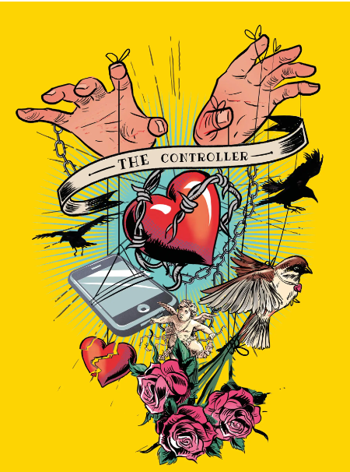
Escape The Trap

Slide 3
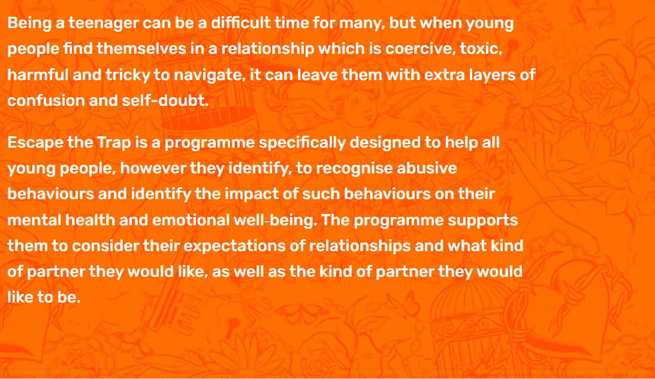
Escape The Trap
Escape The Trap

Slide 4
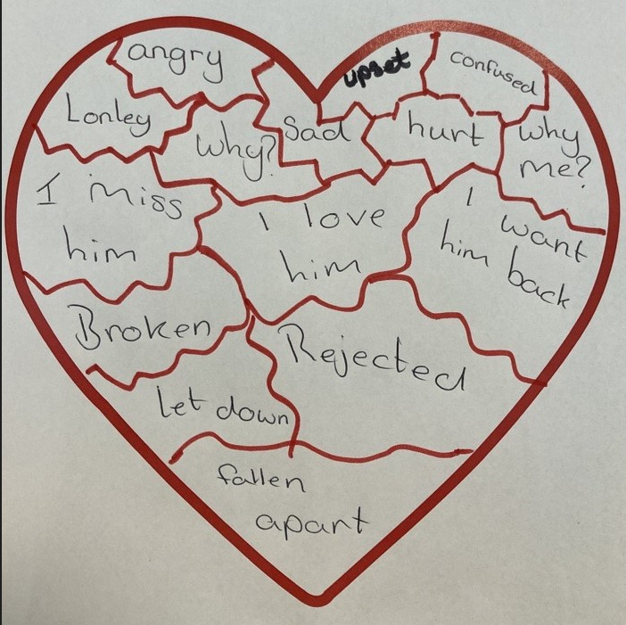
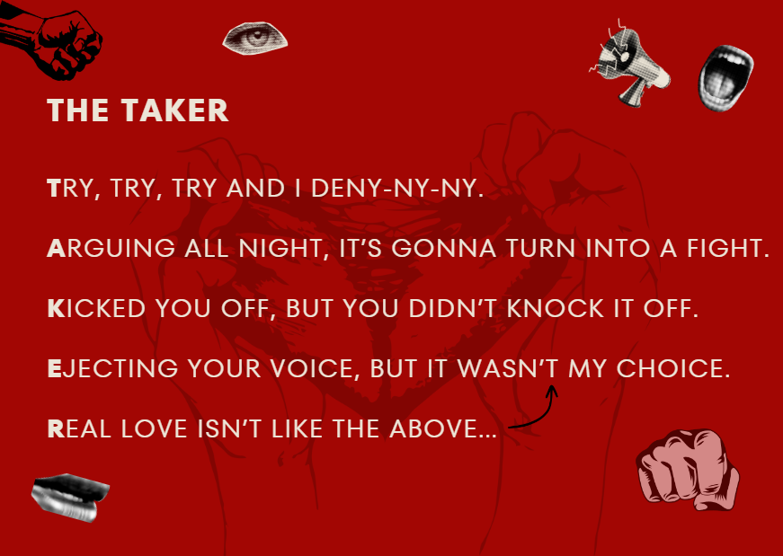
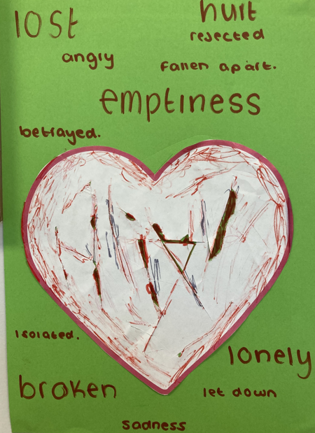
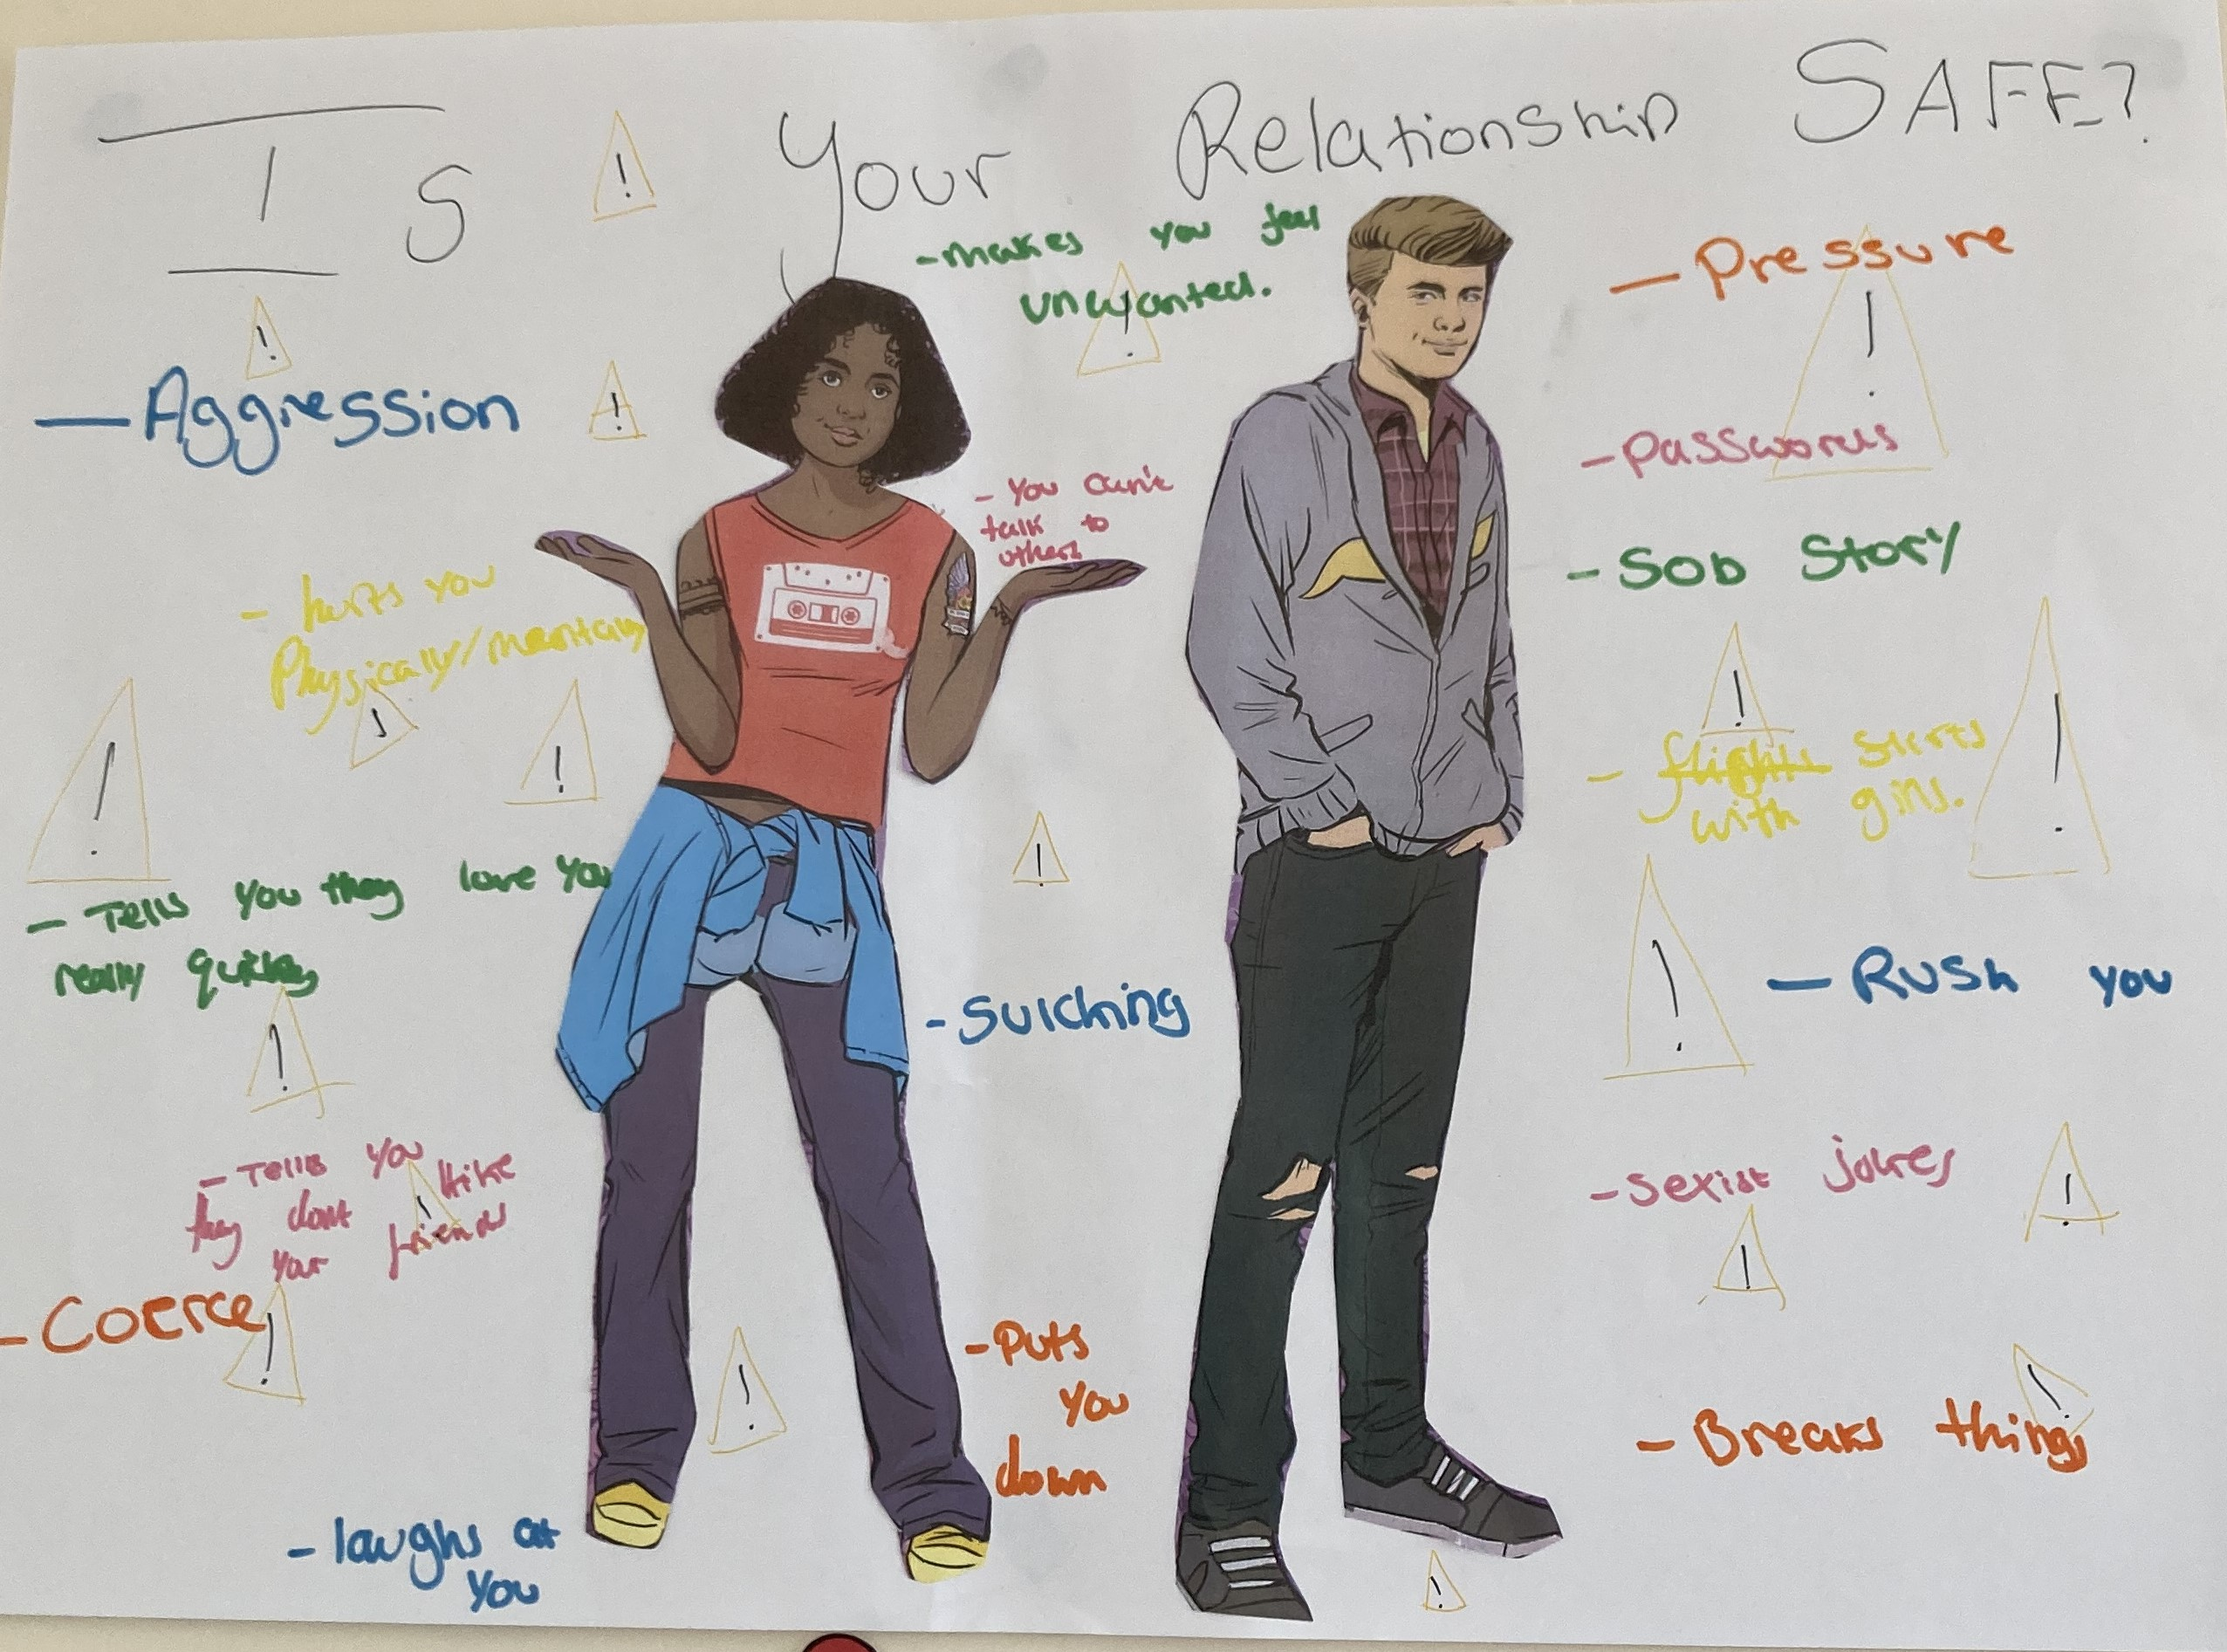
Some of our groups work

Slide 5
Junction
EXPECT RESPECT
Each session is designed to be active, fun and engaging, but also challenging. Whilst not all the session plans raise domestic abuse directly, they have been written using themes found to be effective in tackling domestic abuse, such as:
• challenging assumptions about gender, power and equality;
• changing beliefs and attitudes about men and women;
• managing feelings and accepting responsibility for one’s own feelings and behaviours;
• helping to resolve conflict;
• knowing the difference between abusive and non-abusive relationships;
• understanding our digital footprints;
• promoting the consistent message that abuse is not acceptable;
• understanding that domestic abuse is a crime;
• highlighting the role of peers in providing support;
• understanding consent online and offline;
• knowing the impact of our actions online;
• giving information about where to get help.

Slide 6
EXPECT RESPECT
Previously, the inclusion of domestic abuse within school lessons had been patchy and inconsistent. Women’s Aid has updated The Expect Respect Toolkit to provide a range of session plans to explore the issue of domestic abuse in an age-appropriate way.
Each session plan is designed to stand alone, although they do build on knowledge and awareness from session to session. Supporting resources to deliver them are provided with each session plan and, once they have been downloaded, they can be used without any further access to technology.

Slide 7
EXPECT RESPECT

Slide 8
EXPECT RESPECT

Slide 9
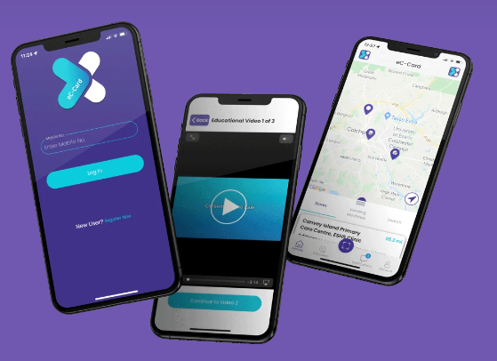
eC-Card
We are a registered venue for eC-Card and our yp support worker is an assessor and able to support
young people with giving out free condoms and lube to under 16’s

Slide 10
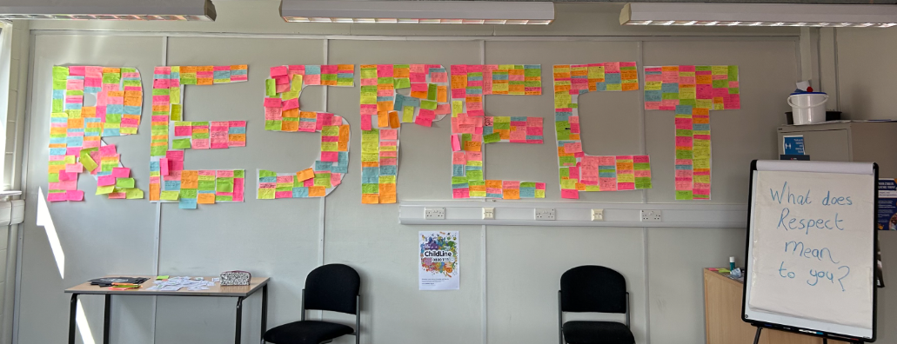
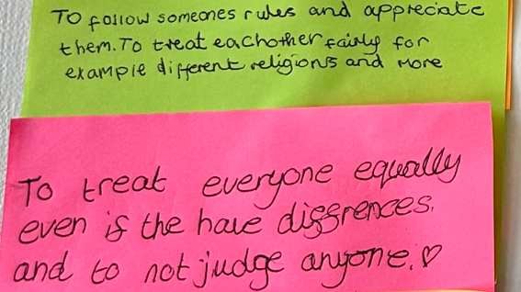
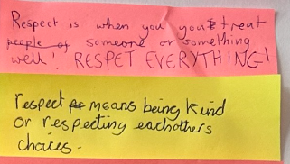
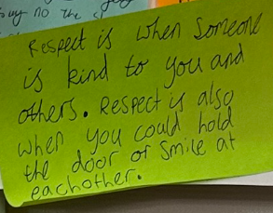
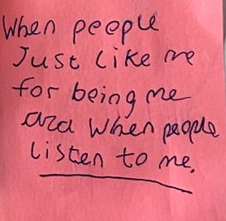
Crucial Crew

Slide 11
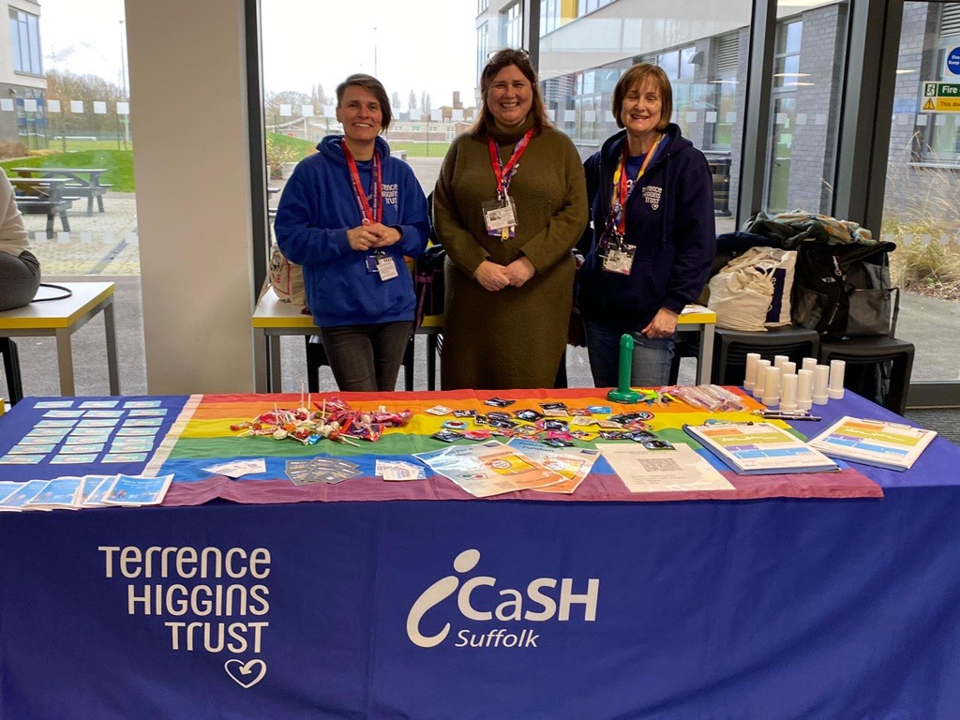
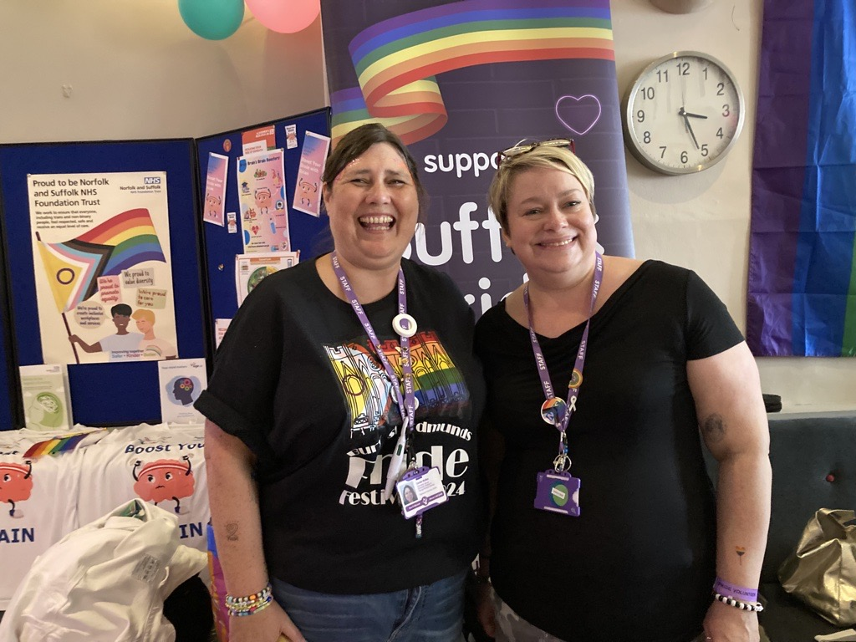
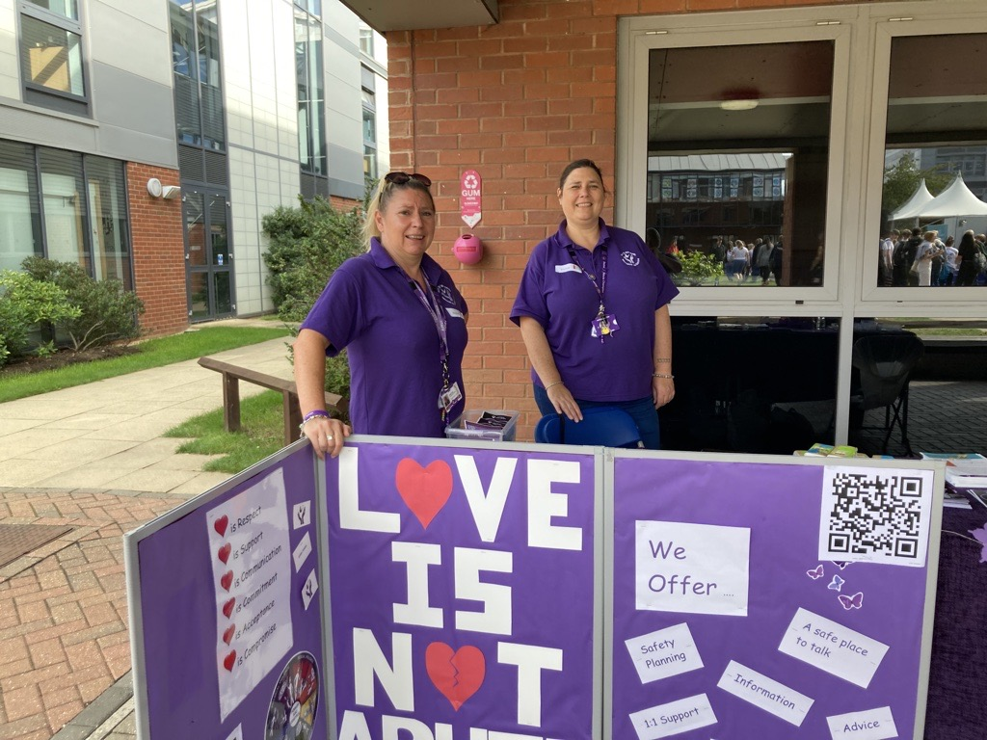
Freshers & Other Events

Slide 12
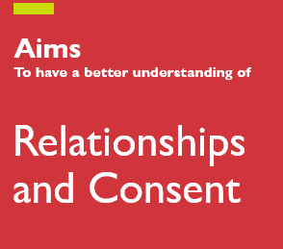
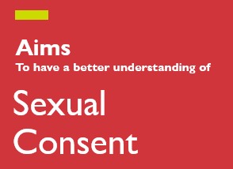
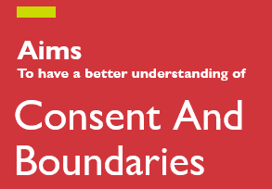
DROP DOWN DAYS IN HIGH SCHOOLS – bespoke

Slide 13
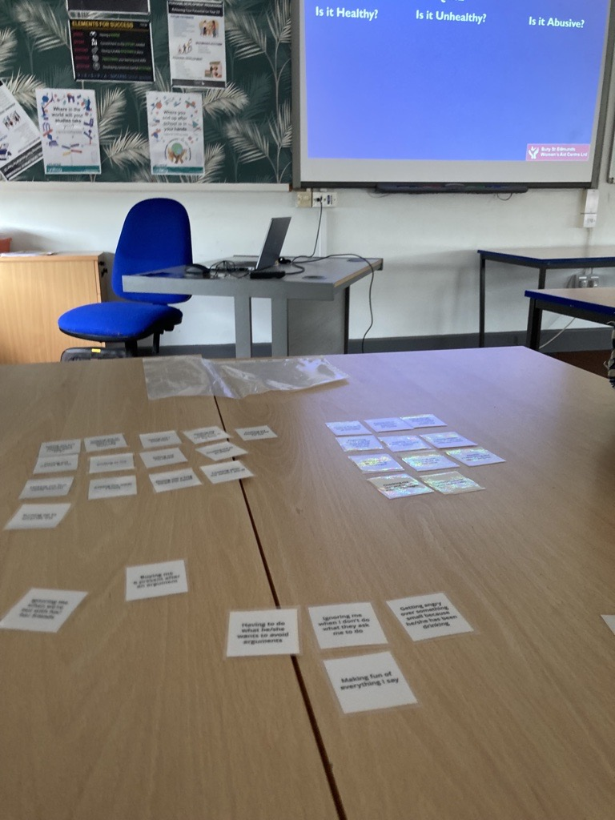
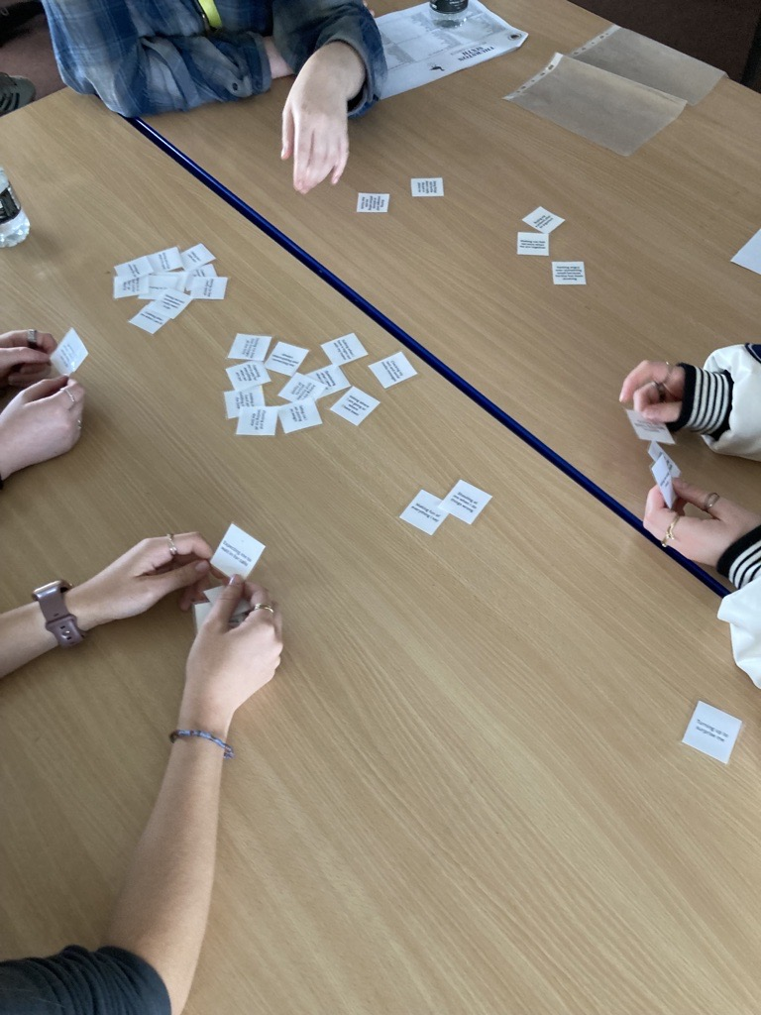
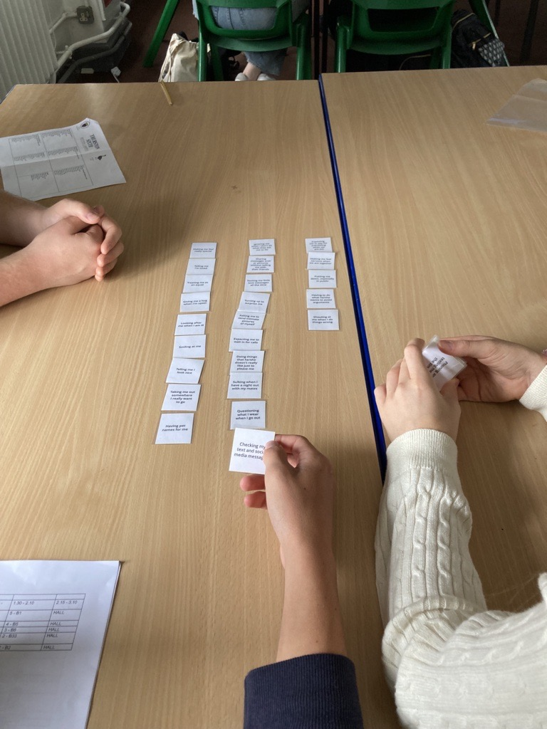

Slide 14
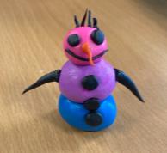
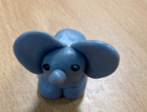
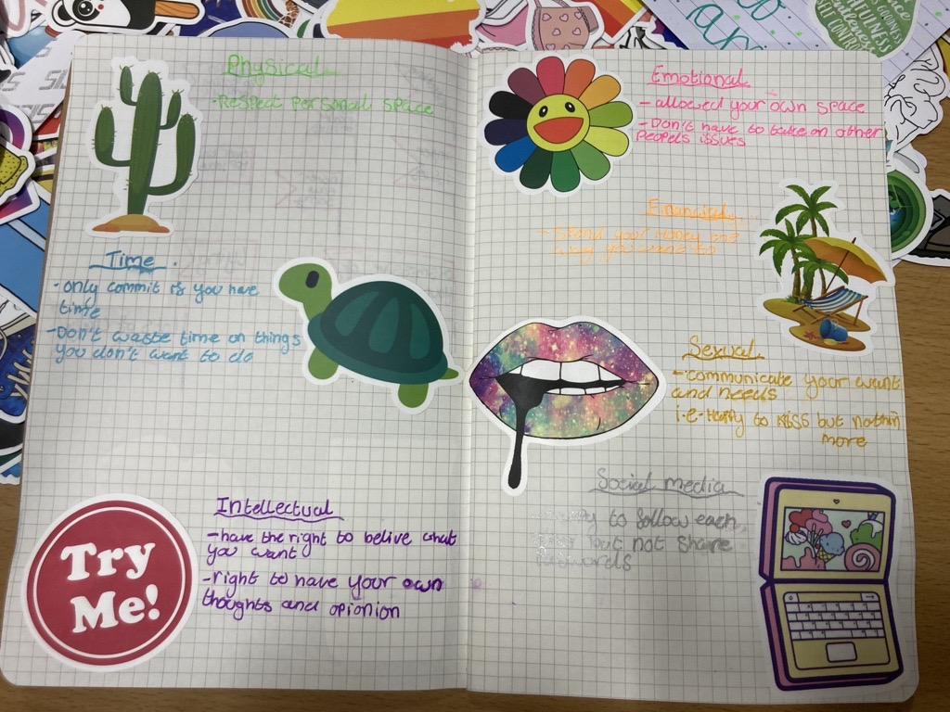
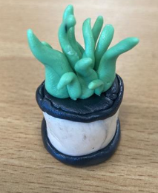
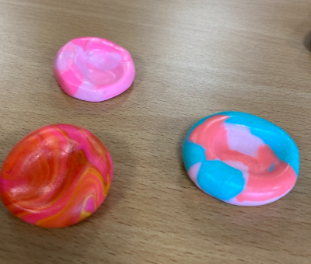
1-1 YOUNG PEOPLE’S SUPPORT
We accepted referrals form Schools, Colleges, Universities, Pastoral teams, Social Care, FSP’s, Parents, Self.
We are client led with the work we do. We look at areas they are struggling with e.g. boundaries and tailor the sessions to suit the clients including some creative work

Slide 15
Helping Hands
The Helping Hands Programme is a 10 week-long programme, designed for Primary School aged children (KS1& 2/ age 5-11) and looks to explore protective behaviour themes, helping children to identify feelings and how they impact behaviours in others and themselves.
The overall aim of the programme is “to increase children’s understanding of feeling safe and to explore and promote behaviours which will contribute to a safe environment.”
Each session builds on the knowledge from the previous week. It has been developed to encourage creativity and play as tools to investigate and reflect on their thoughts, experiences and understanding of safety, empowerment and resilience.

Slide 16
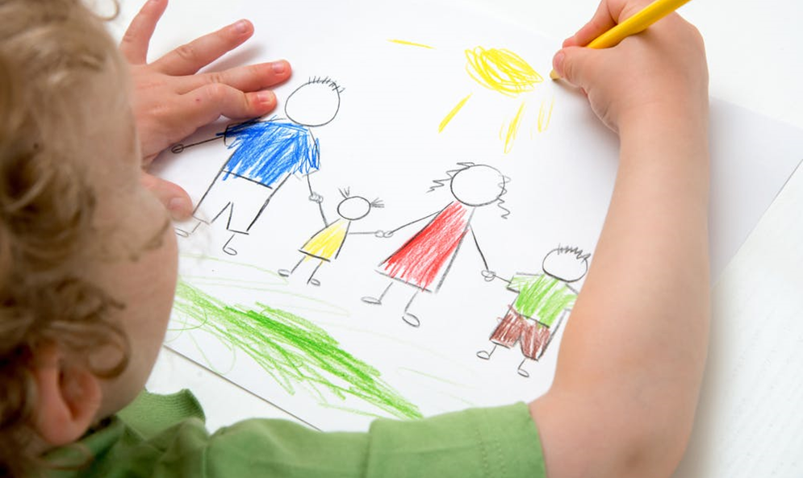
Drawing & Talking
D&T is an attachment based therapeutic intervention, using a non-directive, gentle approach to enable clients to explore their inner thoughts and feelings in a creative and safe way.
It can be used for both one-to-one and group sessions and as advanced trained practitioners, we can also provide individual sand play sessions which are particularly useful for younger clients who require a non-verbal way to explore and process their emotions.
Drawing and Talking, used as an early intervention technique to compliment CAHMS and other specialty services, has shown to be a valuable resource in supporting early childhood development and long term emotional resilience. Statistics show that 50% of lifelong mental health issues can be diagnosed before the age of 14, usually preceded by a range of smaller non-specific emotional-social difficulties in life, which is why early intervention is key.

Slide 17
Who's in Charge?
From October, Restore will be facilitating a new program aimed at parents whose children are behaving violently or abusively towards them(CPV-child to parent violence) or who appear out of parental control.
The program consists of 8, two and a half hour sessions and a 2 month follow up.
Who's in charge is divided into three sections: 1. Exploring how childrens behaviour is multi-causal, deconstructing unhelpful myths about their behaviour that contribute to guilt, shame and blame. This section also helps parents to identify social changes, parenting styles, nature of abuse and entitlement and power that are likely to make child to parent violence more likely. 2. Looks to acknowledge the difficulties parents face when trying to implement boundaries and consequences and the challenges that come with that for those experiencing CPV. The course seeks to empower the parents and therefore promote a more positive balance between child and parent and improve the overall relationship between them. 3. The third and final part of the program supports the parents to make positive changes and reinforce them whilst also working on some advanced topics. There are focussed on anger, assertiveness and self-care. Parents will be supported to become self-reflective in order to gain a deeper understanding of themselves which will enhance their ability to remain empowered in their relationships with their children.

Slide 18
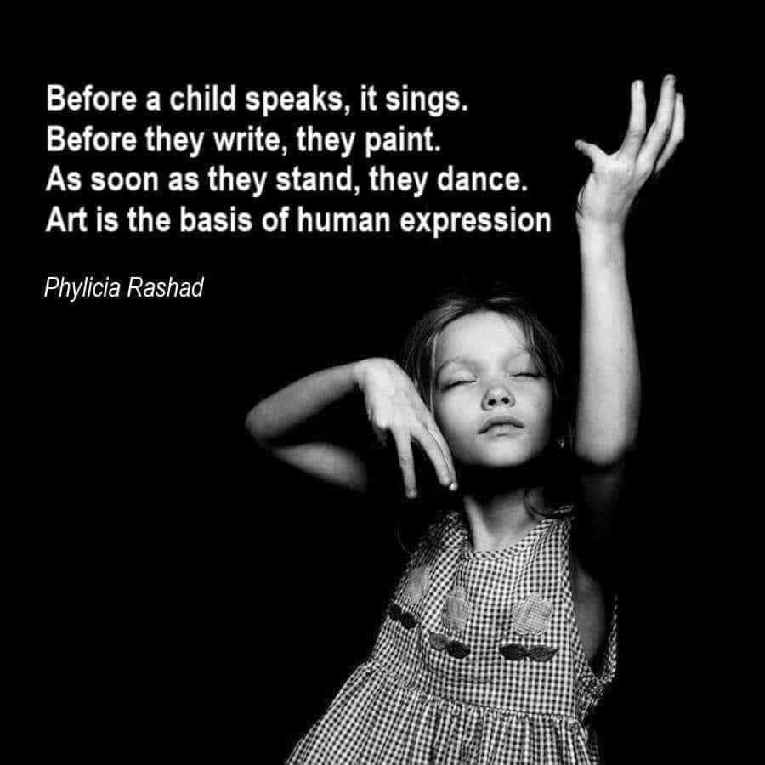
Play Therapy
At Restore, we also have some availability for children to access some free Play Therapy with a member of staff who is completing the final part of their Play Therapy qualification.
To qualify, children will need to be referred by staff at Restore or a member of school staff and there is some eligibility criteria that needs to be met.
What is Play Therapy?
A method of helping children with behaviour and emotional difficulties to help themselves identify uncomfortable feelings.
•Play is the child’s natural medium of self-expression. This has been shown to be essential to child development and well-being.
•Therapeutic Play offers an opportunity for individuals to “play out” their feelings and emotions in a safe, non-judgmental space with a therapeutic objective.
Using play means that the child can explore their thoughts and feelings in creative and dynamic ways, without having to use words to articulate themselves. In Play Therapy sessions, children explore their own creativity and express themselves using media such as: drawing and painting, clay, sand tray and miniatures, guided imagery and relaxation techniques, drama and puppetry, storytelling movement and music.

Slide 19
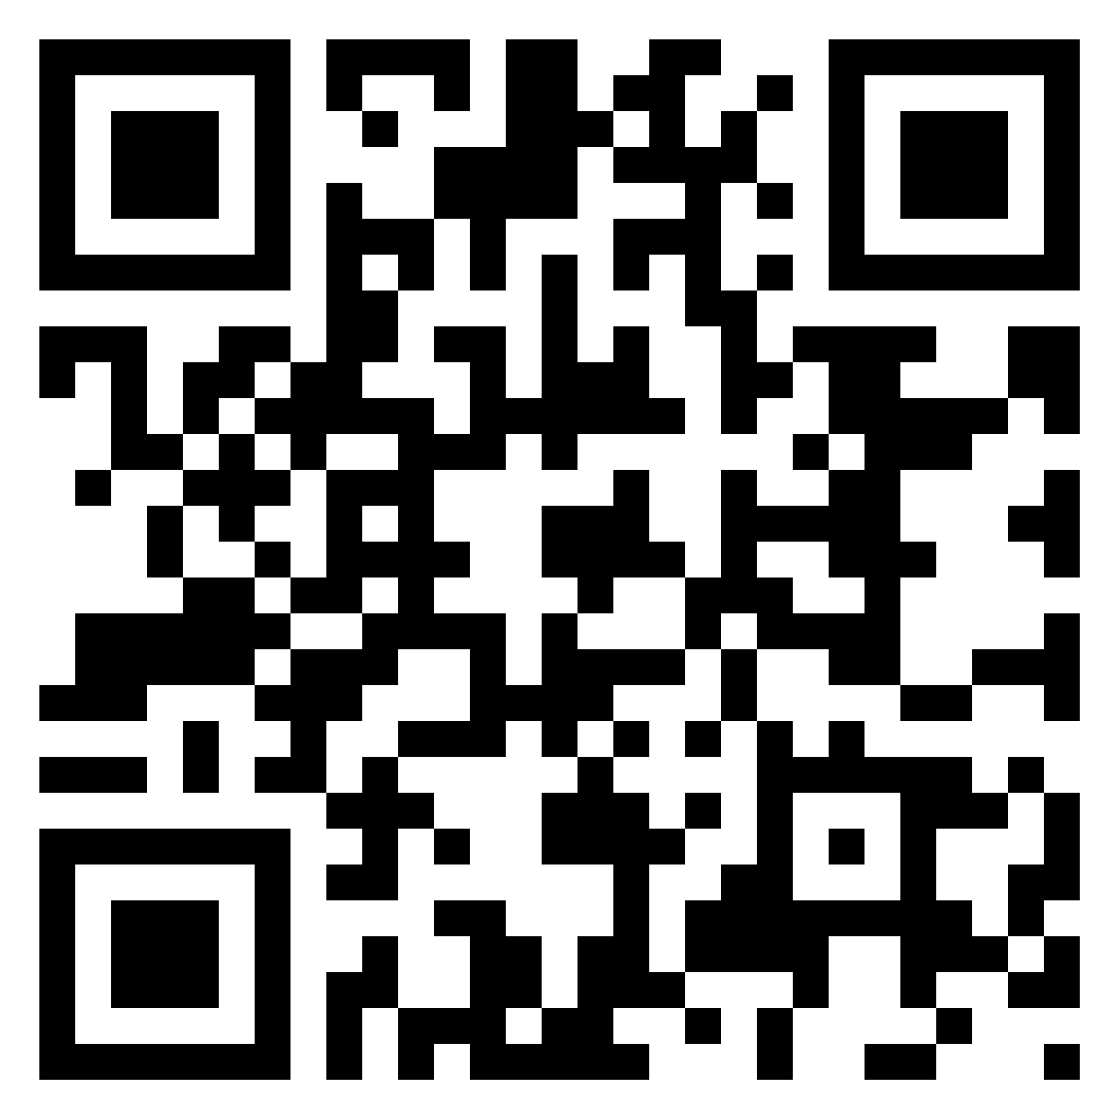
Junction
A Padlet – containing support links for young people

Slide 20
Contact:
Email: louise@restore-wa.org.uk
Phone: 03305519495
Mobile: 07901320192

